Slide 1
Modern 2D Barcodes from Microsoft and 5 minutes of WP7 Mythbusting
Catalin Gheorghiu
19-12-2011

Slide 2
Agenda
De ce barcode?
Ce altele mai exista
High Capacity Colour Barcode
Microsoft Tag
Ce solutii am putea imagina
Q&A
WP7 Mythbusting

Slide 3
Tema de barcodat
http://www.mobilemonday.ro/events/mobile-development-and-mobile-tagging/

Slide 4
Linear (1D) Code 128

Slide 5
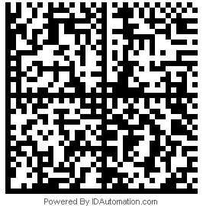
DataMatrix 2D

Slide 6
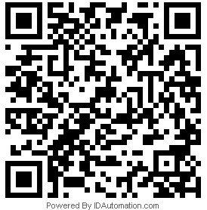
QRCode 2D

Slide 7
Microsoft Tag (HCCB)

Slide 8
Microsoft Tag (HCCB)

Slide 9
Microsoft Tag (HCCB)

Slide 10
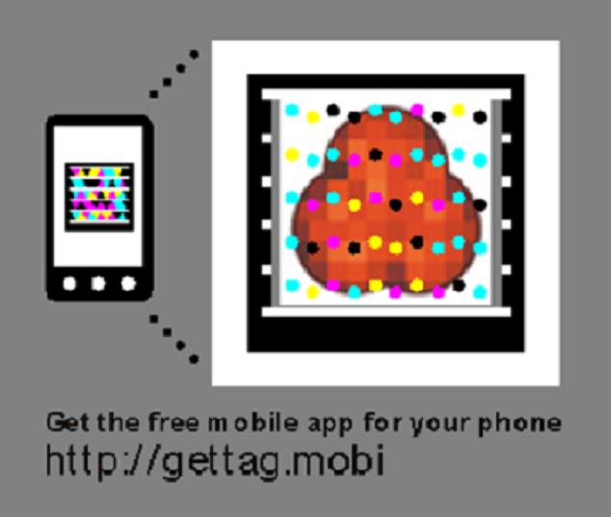
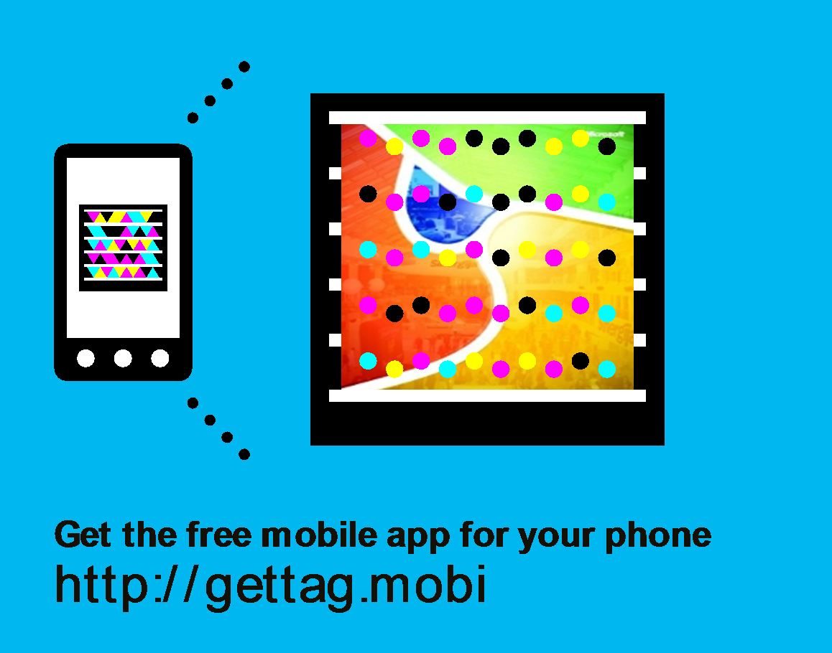
I’m a developer ☺

Slide 11
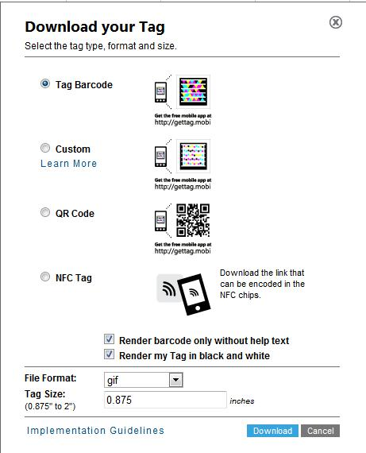
This week news

Slide 12
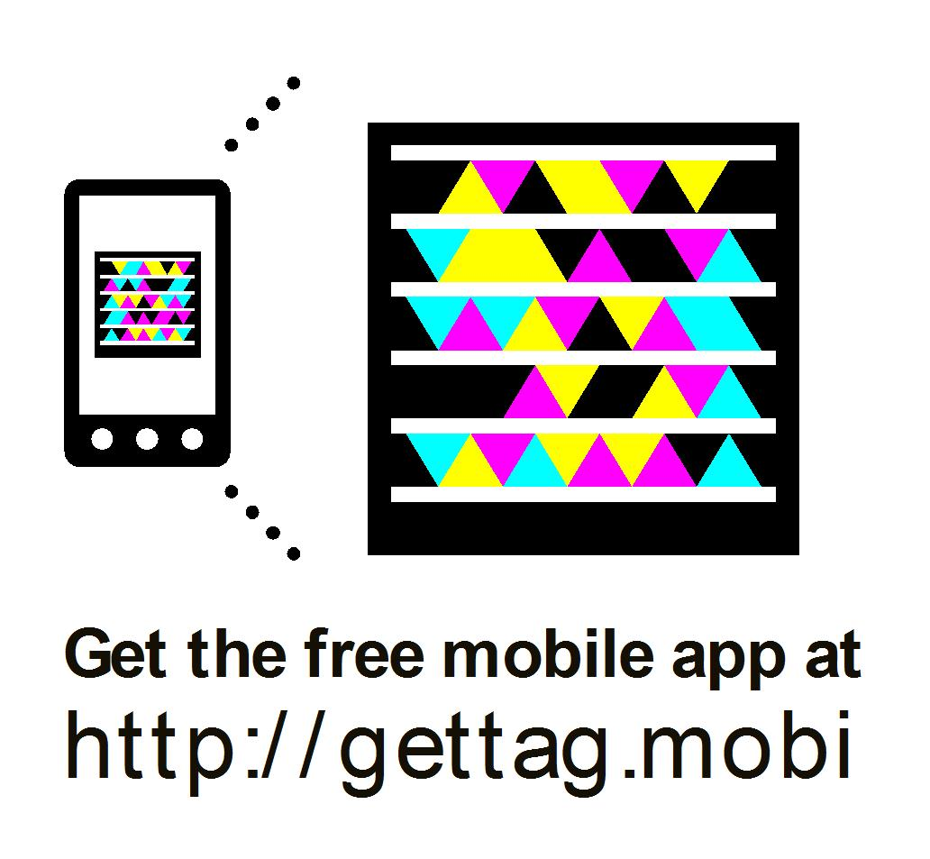
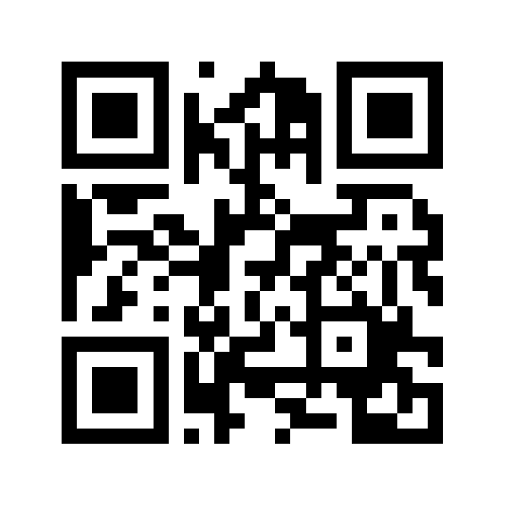

Slide 13
Q&A

Slide 14
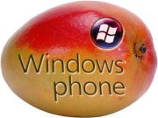
WP 7 Mythbusting

Slide 15
Thank you for your attention.
Contact:
My Blog http://ronua.ro/CS/blogs/catalin/default.aspx
My Email catalin.gheorghiu@ronua.ro

